Slide 1
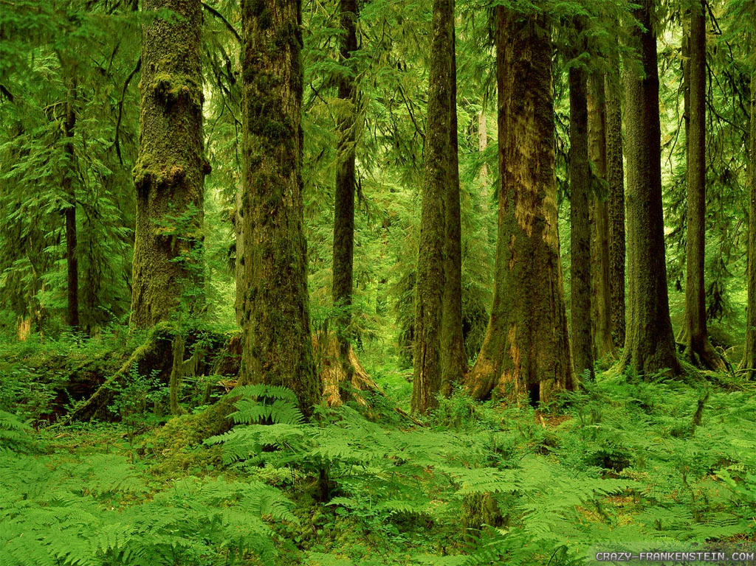

Forest School
ITC Level 3
Certificate in Forest School Programme Leadership
(QCF) Qualification Number: 601/4039/2
Colette Cookson
Caroline Chamberlain
Jon Chamberlain

Slide 2
Forest School
What is it?
Where did it come from?

Slide 3
Forest School
The Forest School Ethos
‘Forest School is an inspirational process that offers all ages regular opportunities to achieve and develop confidence through hands-on learning in a woodland environment.’
Forest Education Initiative 1992 - 2009
www.forestry.gov.uk

Slide 4
Forest School
6 Principles of Forest School
(www.forestschoolassociation.org)
Forest School is a long-term process of frequent and regular sessions in a woodland or natural environment, rather than a one-off visit. Planning, adaptation, observations and reviewing are integral elements of Forest School.
Forest School takes place in a woodland or natural wooded environment to support the development of a relationship between the learner and the natural world.
Forest School aims to promote the holistic development of all those involved, fostering resilient, confident, independent and creative learners.
Forest School offers learners the opportunity to take supported risks appropriate to the environment and to themselves.
Forest School is run by qualified Forest School practitioners who continuously maintain and develop their professional practice.
Forest School uses a range of learner-centred processes to create a community for development and learning.

Slide 5
Forest School
6 Principles of Forest School
Principle 1:
Forest School is a long-term process of frequent and regular sessions in a woodland or natural environment, rather than a one-off visit.
Planning, adaptation, observations and reviewing are integral elements of Forest School.
FS sessions take place weekly/fortnightly, with the same group of learners, if possible encompassing the seasons.
FS sessions are progressive.
FS sessions need physical and behavioural boundaries.

Slide 6
Forest School
6 Principles of Forest School
Principle 2:
Forest School takes place in a woodland or natural wooded environment to support the development of a relationship between the learner and the natural world.
Area or woodland chosen to match the needs of the learners
Need to monitor ecological impact and work within a sustainable site management plan
FS seeks to foster relationships with nature so individuals care about their natural environment
FS uses natural resources

Slide 7
Forest School
‘The setting is not the usual one, it is wilder.
If it is a forest so much the better.
All wild spaces are better than indoors.’
(Sara Knight, 2011)

Slide 8
Forest School
6 Principles of Forest School
Principle 3:
Forest School aims to promote the holistic development of all those involved, fostering resilient, confident, independent and creative learners.
FS develops the physical, social, cognitive, emotional, spiritual self. (Multiple Intelligences – Howard Gardner)
Cognitive – thinking, knowing
Affective – feelings, self & relationships
Psychomotor – doing/ hands on (Bloom’s Taxonomy)

Slide 9
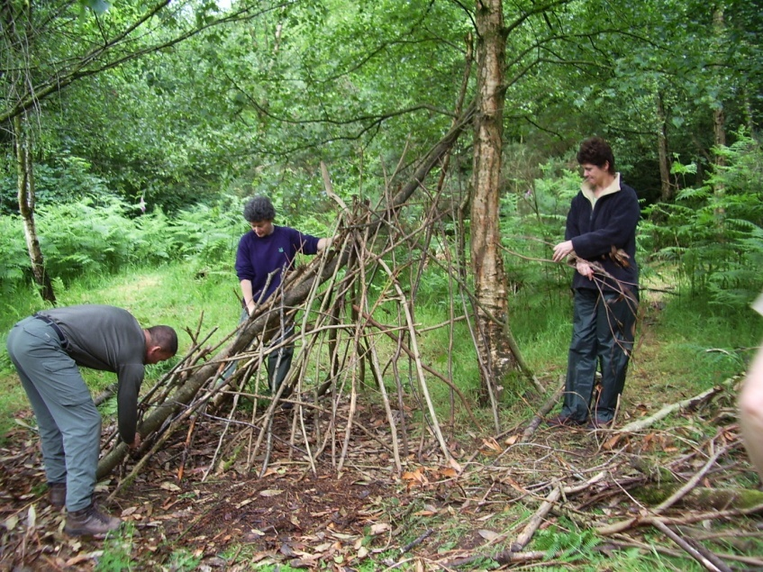
Forest School
Social skills - It encourages team work, cooperation and responsibility.
Emotional Intelligence FS improves self esteem and promotes independence and self-reliance

Slide 10
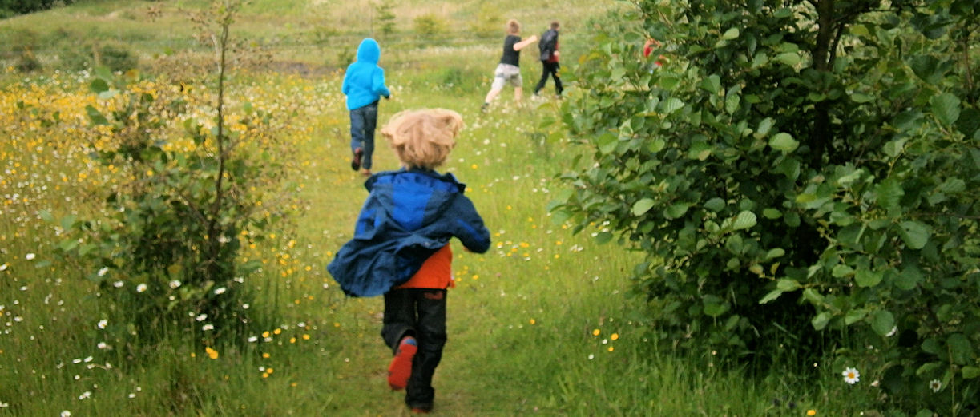
Forest School
Physical skills - It encourages spacial awareness, opportunities for running around outdoors and encourages a healthy lifestyle.

Slide 11
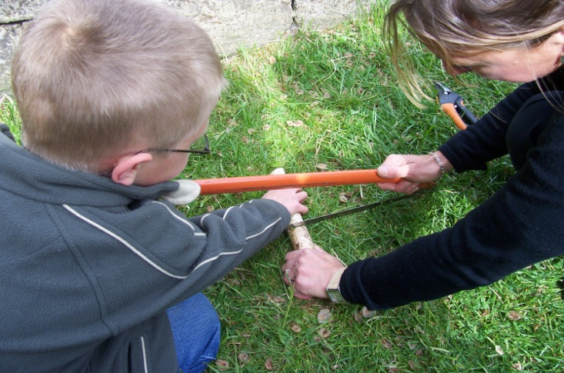
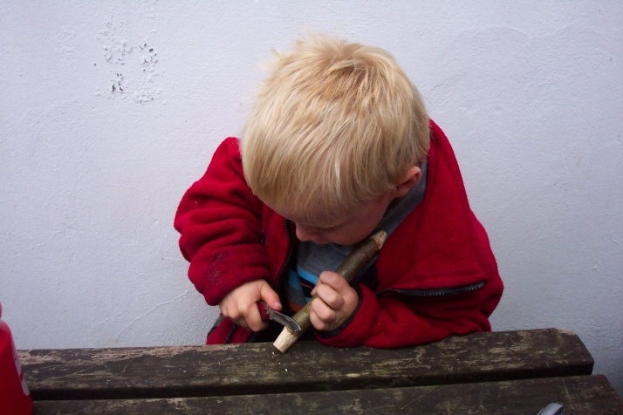
Forest School
Intellectual development - It creates opportunities for experiential learning and the development of new skills and experiences…

Slide 12
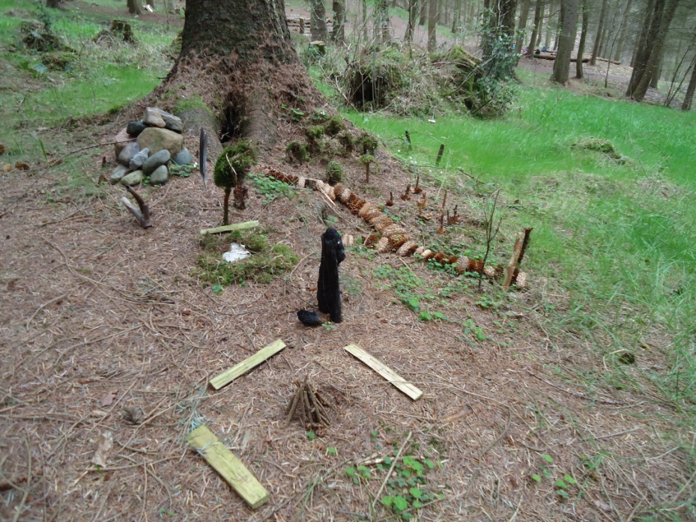
Forest School
Creativity

Slide 13
Forest School
Learning Theories
Early1900’s Behaviourism
1950 Cognitive Psychology
1970 Constructivism – Piaget
Social Learning Theories – Bandura
Experiential Learning – Carl Rogers
1983 Multiple Intelligences Howard Gardner
Late 1980’s Socio – constructivism - Vygotsky

Slide 14
Forest School
6 Principles of Forest School
Principle 4:
Forest School offers learners the opportunity to take supported risks appropriate to the environment and to themselves.
FS may use tools & fires where deemed appropriate to the learners.
FS follows a risk – benefit process tailored to the developmental stage of the learner.

Slide 15
Forest School
‘It is a safe enough environment where children learn to keep themselves safe by taking manageable risks. When participants manage their own risk it raises confidence and self esteem.’
(Sara Knight, 2011)
No Fear – Growing up in a Risk Averse Society, Gill, T 2007
Too Safe for Their Own Good, Linden, J 2011

Slide 16
Forest School
6 Principles of Forest School
Principle 5:
Forest School is run by qualified Forest School practitioners who continuously maintain and develop their professional practice.
Minimum level 3 to lead sessions
High ratio of practitioner/adults to learners
Helpers subject to relevant checks
Practitioners must hold an up to date First Aid qualification to include outdoor/forest school and paediatric elements
FS is backed by policies and procedures
FS leader is reflective practitioner and is therefore a learner too
The role of the Forest School leader………

Slide 17
Forest School
6 Principles of Forest School
Principle 6:
Forest School uses a range of learner-centred processes to create a community for development and learning.
Experiential learning - Child led
Play and choice are integral to FS
Play vital to learning
Reflection is a feature of each FS session

Slide 18
Forest School
‘Forest School is a way of working in an outdoor environment, preferably but not exclusively in wooded settings. This is based on the premise that repeated enjoyable outdoor experiences will have a positive effect on people, including on their personal dispositions for learning or for personal change.’
Sara Knight, 2011

Slide 19
Forest School
ITC Level 3
Certificate in Forest School Programme Leadership
(QCF) Qualification Number: 601/4039/2
Theory Portfolio
Plan/Deliver/Reflect Portfolio
Skills Portfolio

