Slide 1
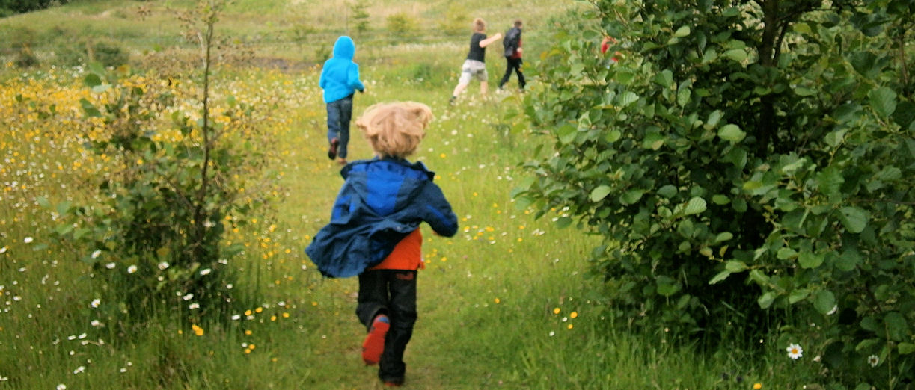

Forest School
Children’s Play today
Indoors
Technology led
Confined, controlled spaces
Consumer led toy/console industry
Restricted by fears about child abduction
Evidence of children mugged for their trainers & mobile phones
Urban dominated environments

Slide 2
Forest School
‘Sadly parents seldom do much to widen their young children’s horizons.’
(Palmer, 2007)

Slide 3
Forest School
Play
Natural England Research 2009
Less than 10% of children play in natural outdoor spaces
Compared to 40 % of adults (when they were young)
81 % of children said they would like more freedom to play outside
50 % would like to play outside but weren’t allowed
25 % of children were worried about playing outside

Slide 4
Forest School
‘I like to play indoors because that’s where all the electrical outlets are.’
(Anonymous child)

Slide 5
Forest School
We need to be sensitive to the needs and insecurities of children, parents and colleagues.
They need to be gradually teased out of their comfort zone.
It is those that dread Forest School who need it the most.

Slide 6
Forest School
Play
Play is freely chosen by the player
Play is personally directed, the manner of playing is decided by the child
Play is engaged in for it’s own sake, the impulse comes from within – the child must find the activity satisfying and derive pleasure from it, this may cause conflict with adult ideas.
The best we can do is to create a playful environment for children and understand that play will start and stop of its own accord. (Perry Else 2009)

Slide 7
Forest School
Play
'Play is the beginning of knowledge.' George Dorsey
'Play is the highest form of research.' Albert Einstein
“You can discover more about a person in an hour of play than in a year of conversation.” Plato
“Play is the only way the highest intelligence of humankind can unfold.” Joseph Chiltern Pearce
'Play is what I do when everyone else has stopped telling me what to do.' Anon child

Slide 8
Forest School
'It is paradoxical that many educators and parents still differentiate between a time for learning and a time for play without seeing the vital connection between them.” Leo F. Buscaglia
'We often contrast play behaviour with serious behaviour but perhaps the truth is that we would be better off treating play as the most serious aspect of all our activities.' Desmond Morris
'It is in play and only in playing that the individual child or adult is able to be creative and use the whole personality and it is only in being creative that the individual discovers the self.' DW Winnicoff

Slide 9
Forest School
Life Today
500,000 Ritalin prescriptions in 2007
‘He seemed not to need the Ritalin in the woods.’ (Sara Knight, 2011)
‘Children exhibited far fewer symptoms of ADHD after spending time in the woods.’
(Louv, 2005)

Slide 10
Forest School
Challenging behaviour
‘The woods were my Ritalin.’
‘Nature calmed me, focused me and yet excited my senses.’
(Last Child in the Woods, Louv 2005)
‘..he’s another person when out here, nothing like the tearaway he is in the classroom.’
(Sara Knight, 2011)

Slide 11
Forest School
‘Forest School is not just about remediation and healing – it is part of normal growth and development.’
(Sara Knight, 2011)

Slide 12
Forest School
Forest School For All
Part of normal development
Young people with challenging behaviour
Sensory impairment, mobility difficulties, mental health issues
Young people with Autism
Recovering addicts
Struggling families

Slide 13
Forest School
Challenging behaviour
‘Repeated enjoyable outdoor experiences will have a positive effect on people, including on their personal dispositions for learning or for personal change.’
(Sara Knight, 2011)

Slide 14
Forest School
Challenging behaviour
Keep learning fun and positive.
Give lots of praise.
Talk about undesirable behaviour so the act is undesirable not the individual.
Repeatedly ignoring bad behaviour and praising appropriate behaviour will eventually change learned behaviour.

Slide 15
Forest School
More about the benefits of being outside with;
The Green Mind

