Slide 1
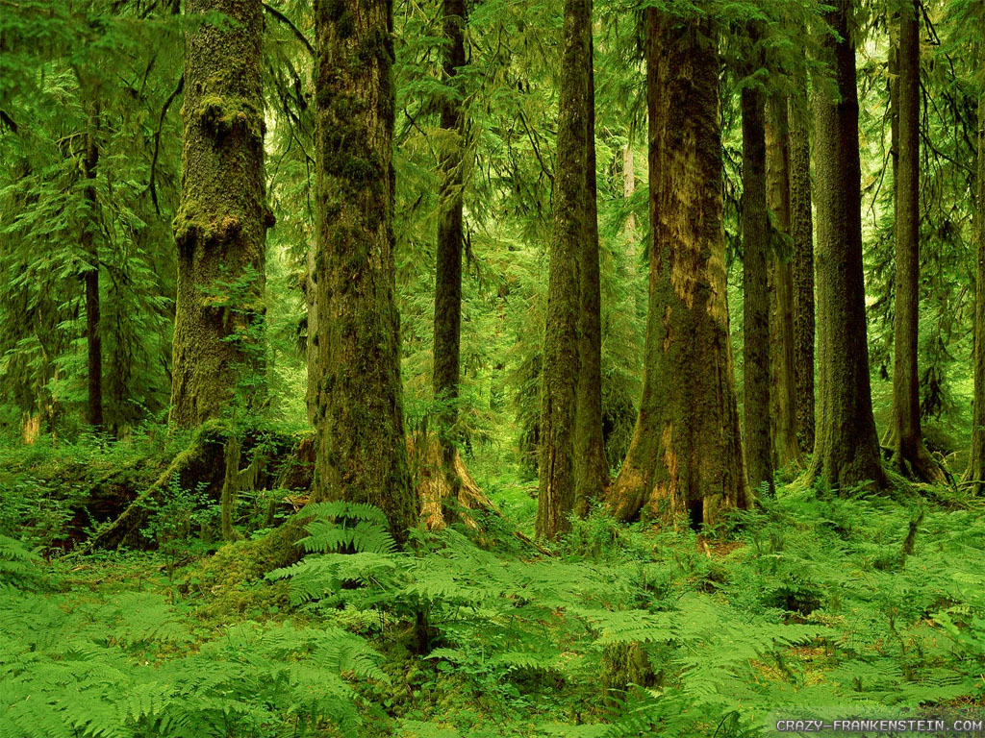

Forest School
ITC Level 3
Certificate in Forest School Programme Leadership
(RQF) Qualification Number: 603/3213/X
Colette Cookson
Caroline Chamberlain
Jon Chamberlain

Slide 2
Forest School
Woodlands

Slide 3
History
500 – 1500 AD Wildwood
1650 – move to coal
1919 – 5% of UK was wooded
- Forestry Commission formed
2021 – Govt plans for 30,000 hectares planted each year
2023 – 13% of UK is wooded
2060 – aiming for 15%
Native trees only
Forestry Commission Decision Support Tool
Trees suited to area
Survive climate change in 100 years

Slide 4
Ancient Woodlands
Forested since 1600
20% of UK woodland is Ancient
Register of Ancient Semi Natural Woodland
Should be left to re-wild, no afforestation
(seed bank)

Slide 5
Woodland Owners
Forestry Commission UKFS
UK Forestry Standard – law
Eg. 28 day rule
Need a licence to fell trees, £2500-£20000 fine
UK Woodland Assurance scheme non statutory guidance to help owners
FC Woodland Management Plan template
……… our Woodland Management Plan

Slide 6
Healthy Woodlands
Healthy = Sustainable
Diversity is key (species and age)
Diversity of species
Mono cultures are susceptible to disease
Similar age trees die of old age and/or storms
Silviculture – controlling growth, composition and quality of forests

Slide 7
Sustainability
Diversity of Age
Control light levels
Control health & age
Thinning & Felling
Coppice & Pollard

Slide 8
Ancient Woodlands
Naturally Diverse
Non Intervention
Recover naturally from storms, disease
Seed banks

Slide 9
Sustainability
Afforest a Diversity of Species
Forestry Commission Decision Support Tool
Native trees only
Trees suited to area (don’t change natural ecology )
Survive climate change in 100 years
Ancient Woodlands naturally diverse - no afforestation

Slide 10
Woodland Management Methods
Thinning
Felling
Coppicing
Pollarding
Clear invasives
Non-intervention

Slide 11
Woodland Management Methods
Health Threats
Control methods
Storms
Disease
Pests – deer, rabbits, squirrels, humans
Fungi
Pollard
Species diversity
Deer fencing, tree tubes, bramble brash
hunting
Prevent bark damage
Spotting Tree Hazards activity

Slide 12
Ancient Trees
Provide many habitats, they have;
A very large girth for the species
Hollow or hollowing trunk
Large quantity of deadwood in canopy
Natural water pools
Decay holes
Damage to trunk
Bark damage
Fungi
Epiphytic plants
An ‘old’ look

Slide 13
Tree Preservation Orders
……to protect selected trees and woodlands if their removal would have a significant negative impact on the local environment and its enjoyment by the public
Factors taken into account;
size and form
future potential as an amenity
rarity, cultural or historic value
contribution to, and relationship with, the landscape
contribution to the appearance of a conservation area

Slide 14
Forest School

